Slide 1
Programming Refresher​
Notes:
Let's start with a quick refresher on Python programming basics.

Slide 2
Course Introduction
Notes:
Welcome to the course! Let's start by understanding what we'll be covering.

Slide 3
Introduction to Python
Notes:
Let's begin with an introduction to Python, a versatile programming language.

Slide 4

What Is Python?
Python is an interpreted, object-oriented, and high-level programming language.
It was developed by Guido Van Rossum and released in 1991.
Python is one of the most popular and fastest-growing programming languages.
Notes:
Python is a popular, high-level programming language known for its simplicity and versatility.

Slide 5
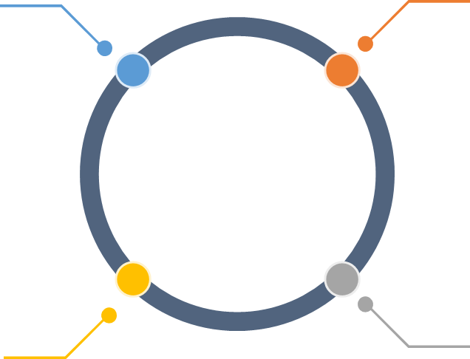
Benefits of Python
Open source:
Python is freely accessible for anyone to use for any purpose.
High-level language:
Python code is understandable due to its simpler and shorter syntax.
Powerful data structures:
Python's sophisticated data structures organize data in an easily accessible manner based on use cases.
Python libraries:
Python offers extensive library modules and package support.
Notes:
This slide is self explanatory

Slide 6
Benefits of Python
Object-oriented programming:
This helps with a structured way of programming in Python.
Interpreted language: Python is an interpreted language; therefore, the compilation process is bypassed, which boosts efficiency.
Dynamically typed:
Python does not require an explicit data type declaration, as it assumes the data type when data is assigned.
Flexibility:
Python's versatility enables users to create any type of application.
Notes:
This slide is self explanatory

Slide 7
Application Domains of Python
Data science and statistics
Machine learning, deep learning and artificial intelligence
2
3
Version Control Systems
4
Data analysis and visualization
Application development
1
CI, CD, and Build Tools
Continuous Monitoring Tools
Web scraping
7
5
Natural language processing
6
Business applications
Notes:
This slide is self explanatory

Slide 8
Demand for Python
In recent years, the demand for Python has rapidly increased. This trend is expected to continue due to several key factors, such as:
Containerization with Docker
Versatility and a wide range of applications
Ease of learning
Strong community support
Adoption in data-centric fields
Growing career opportunities
Notes:
Over the past few years, the demand for Python has been rapidly increasing, and this trend is expected to continue. This surge in popularity can be attributed to several key factors:
Versatility and wide range of applications: Python's versatility allows it to be used in various fields, including web development, data science, machine learning, artificial intelligence, automation, and more. Its ability to adapt to different programming paradigms and its extensive library support make it an indispensable tool for developers.
Ease of learning and use: Python's simple syntax and readability make it an ideal language for beginners and experienced programmers alike. Its ease of learning has led to widespread adoption in educational institutions, where it is often the first language taught.
Strong community and ecosystem: Python boasts a large, active community that contributes to a rich ecosystem of libraries, frameworks, and tools. This community support ensures continuous development, timely updates, and a wealth of resources for learners and professionals.
Adoption in data-centric fields: Python has become the leading language for data science, machine learning, and artificial intelligence. Powerful libraries like pandas, NumPy, TensorFlow, and PyTorch have driven its adoption in these areas, enabling rapid prototyping and development of complex algorithms.
Growing career opportunities: The demand for Python developers is high across various industries, including technology, finance, healthcare, and academia. Job postings frequently list Python as a required or preferred skill, reflecting its growing importance in the job market.

Slide 9
Learning Path
Notes:
Let's outline the learning path you'll follow in this course.

Slide 10
Course Outline
1
3
5
Python Functions
Programming Basics
Python Data Types and Operators
Course Introduction
Introduction to Python Programming
Conditional Statements and Loops
2
4
6
Notes:
This slide is self explanatory

Slide 11
Programming Basics
This lesson outlines the following concepts:
Provides an overview of software
Lists the different programming models
Explains the structure of programming
Notes:
This topic provides an overview of software, lists different programming models, and explains the structure of programming, including concepts like control flow, modularization, data structures, algorithms, and design patterns.

Slide 12
Introduction to Python Programming
This lesson discusses the following concepts:
Definition of Python, history of Python, and advantages of Python
Installing Python
Python IDE
Writing the first Python program
Notes:
This lesson covers the definition, history, and advantages of Python, as well as installing Python, choosing an IDE, and writing your first Python program.

Slide 13
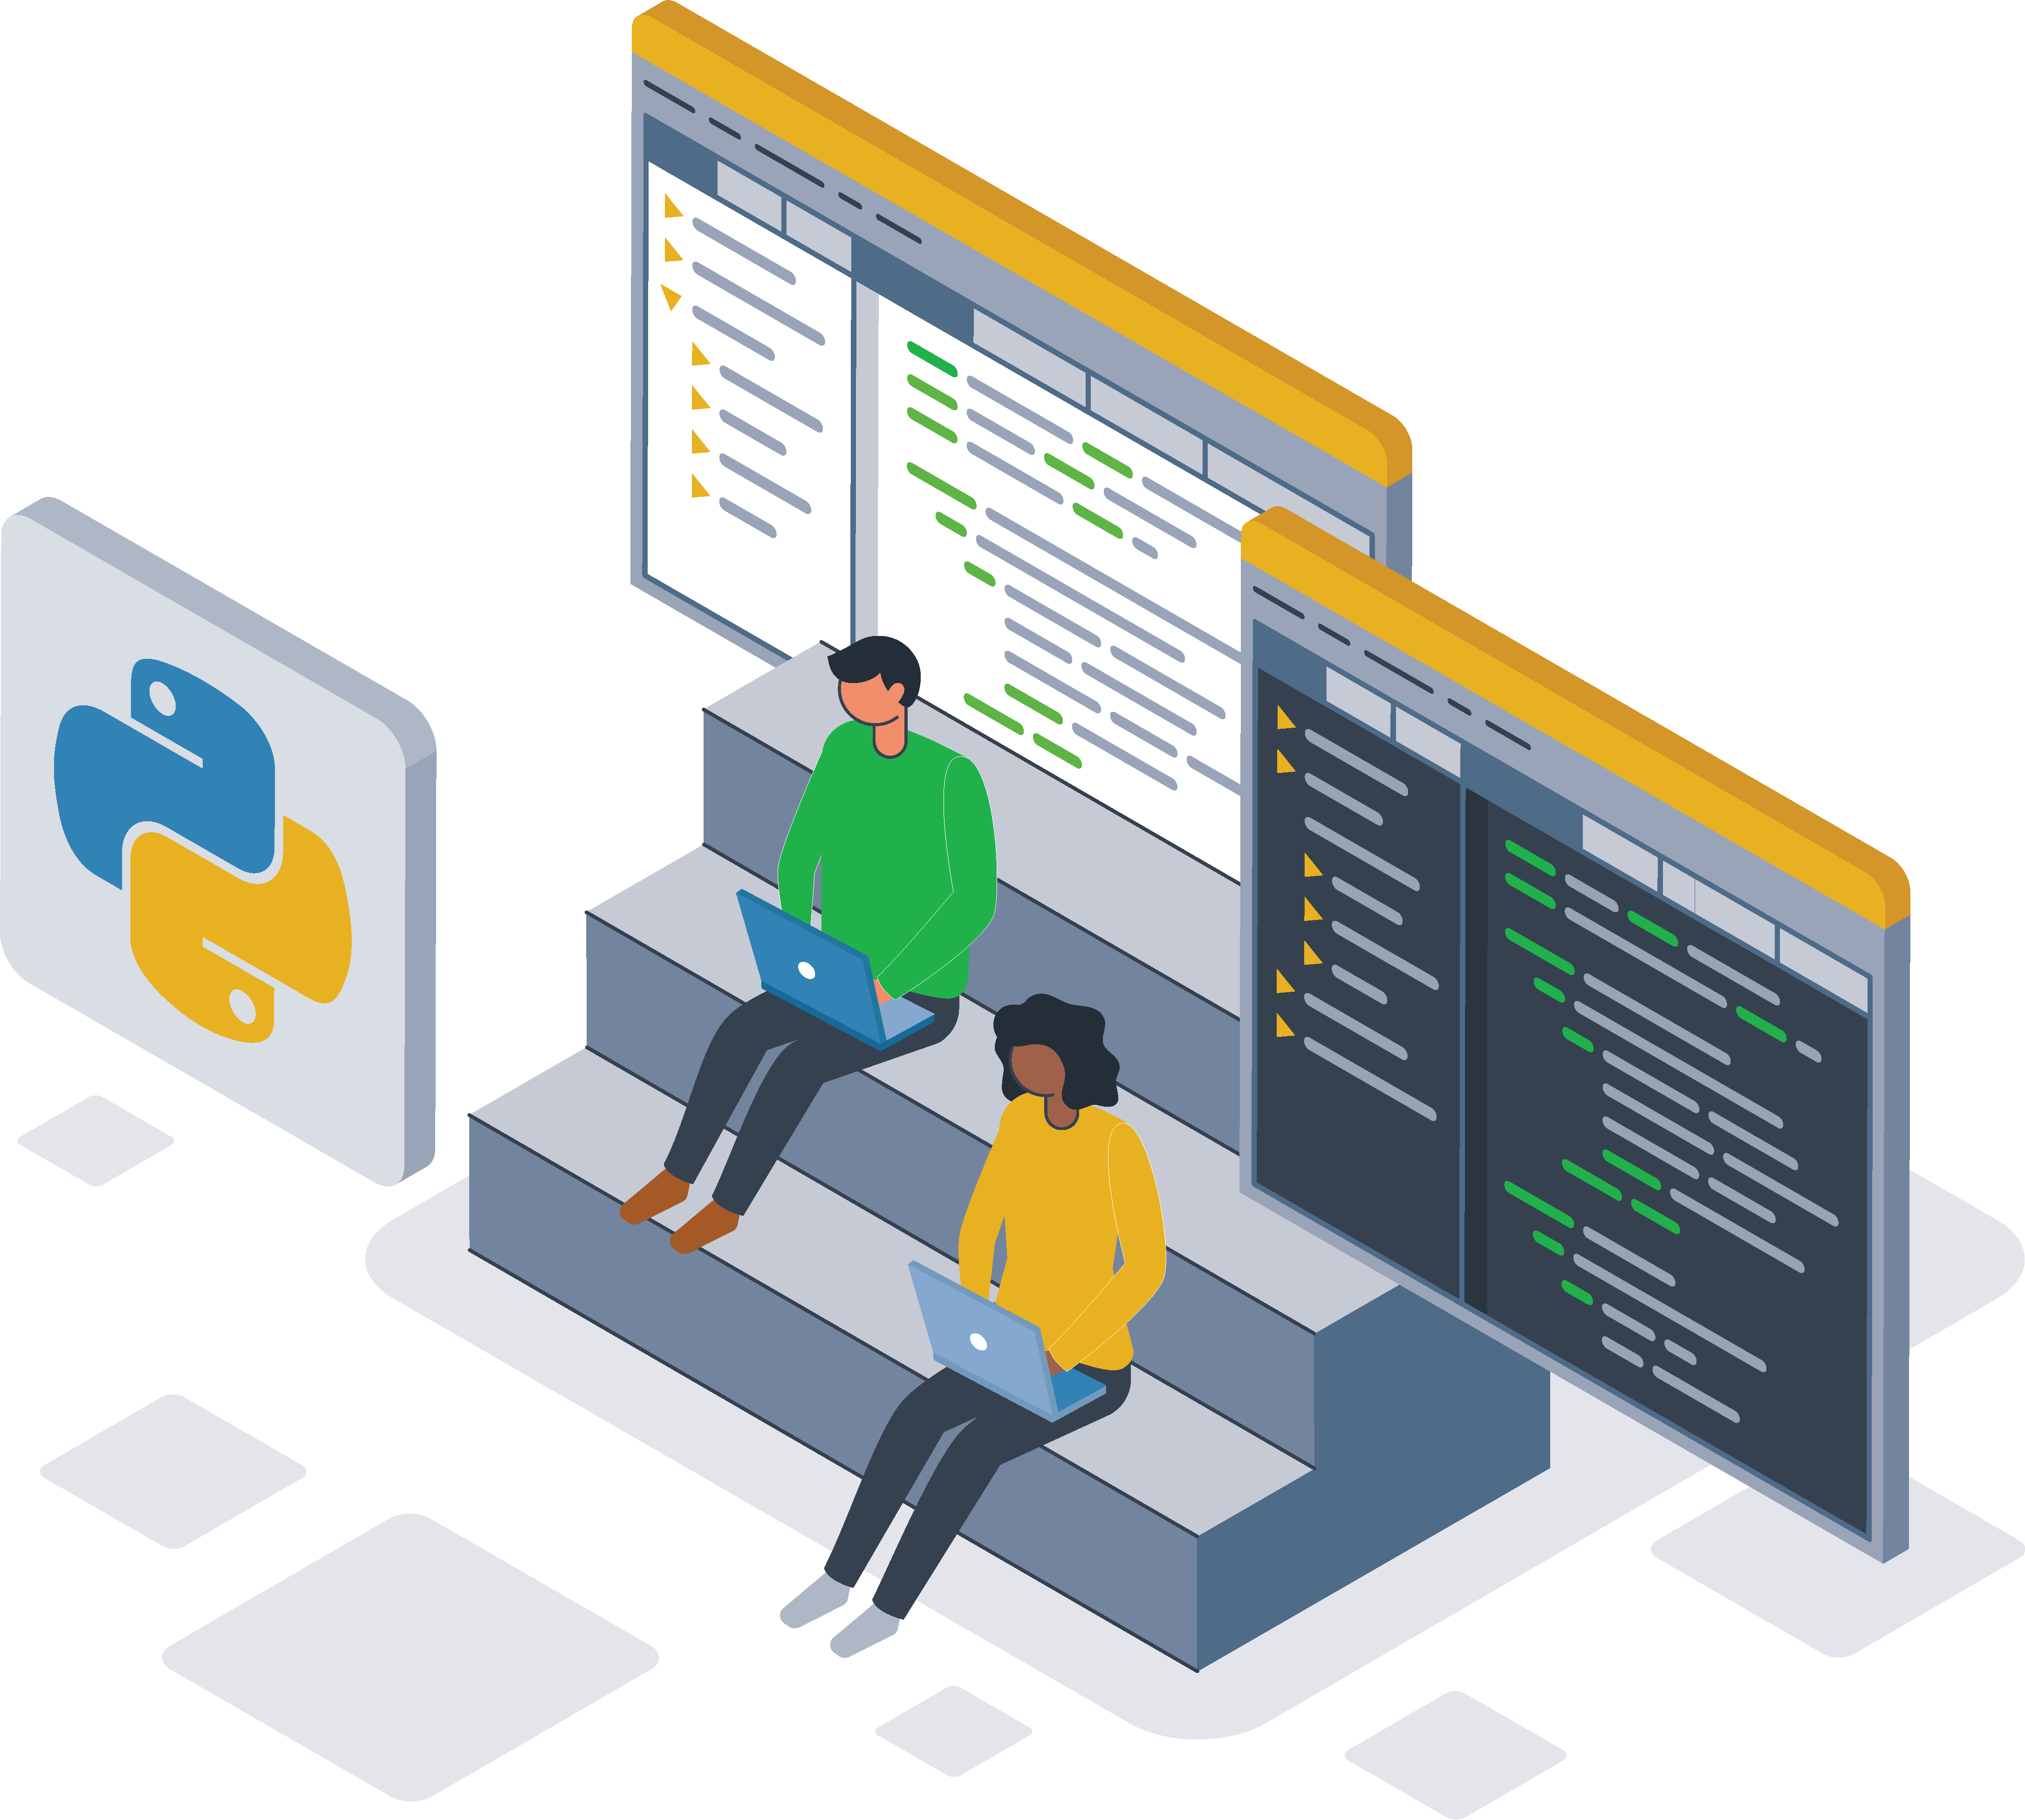
Python Data Types and Operators
This lesson covers the following topics:
Data types and data assignment
Python operators
Strings in Python
File handling in Python
Notes:
This lesson covers data types and data assignments in Python. It includes an exploration of Python operators, with a focus on strings and file handling in Python.

Slide 14
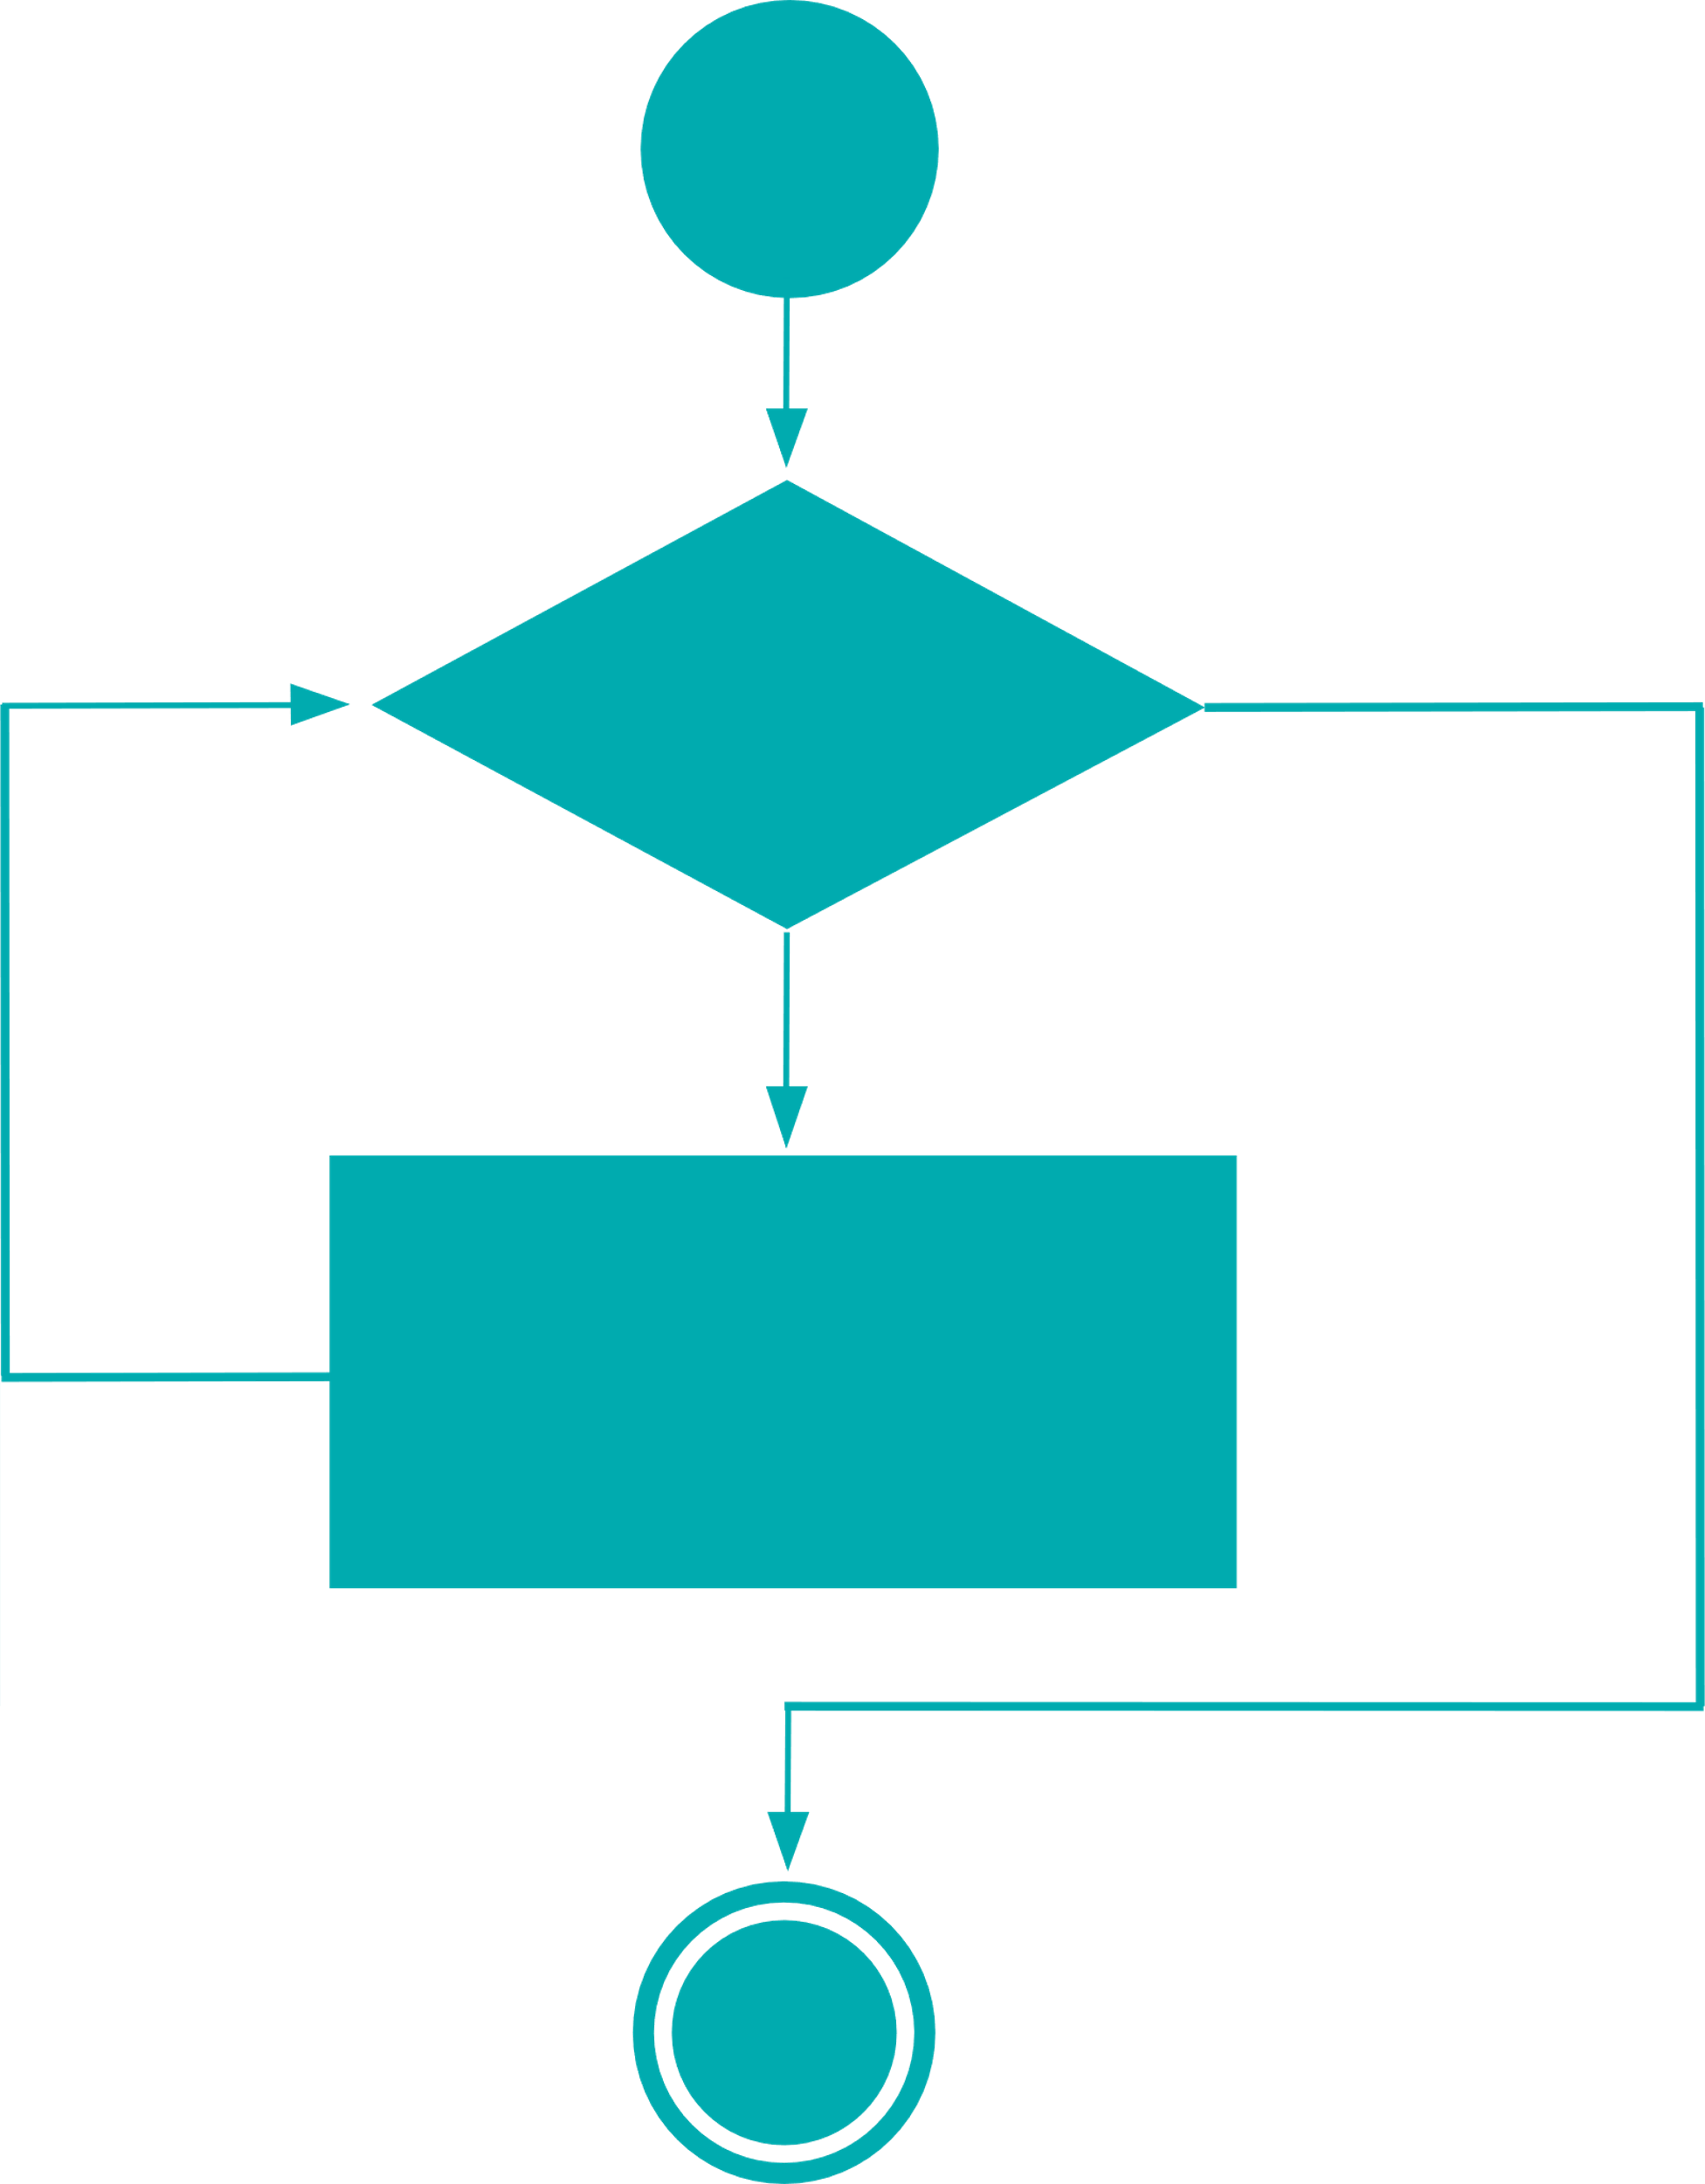
Conditional Statements and Loops
The concepts covered in this lesson includes:
Decision control structures in Python
Types of loops
Loop control statements, such as break and continue
Notes:
This lesson discusses decision control structures in Python, covering different types of loops and loop control statements like break and continue.

Slide 15

Python Functions
This lesson includes the following concepts:
Functions in Python
Function arguments
Return statements
Scope of a variable
Generators function
Function types
def xyz():
-----------
-----------
-----------
def xyz():
-----------
-----------
-----------
Notes:
This lesson explores functions in Python, including function arguments, return statements, variable scope, generator functions, and different types of functions.

Slide 16
Course Components
Notes:
Let's take a look at the key components of this course.

Slide 17

Course Components
E-books: Downloadable PDF files of all lessons to use as quick reference guides
Assisted practices: To help you develop skills and make you an asset to any organization
Notes:
This slide is self explanatory.

Slide 18
Let's get started!
Notes:
Ready to dive in? Let's get started with our course!

